Slide 1
Air resistance- drag

Slide 2
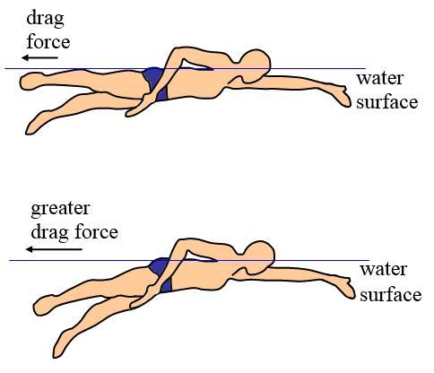
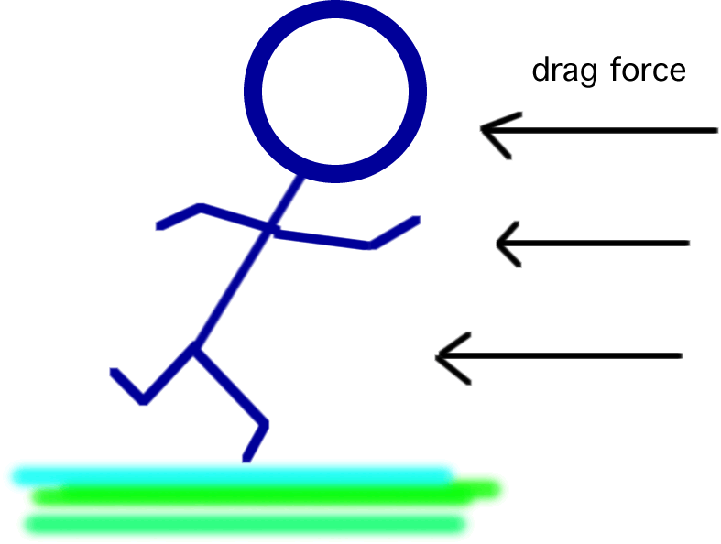
Drag
is a force that opposes the motion of an object when it is moving in a fluid or a gas.

Slide 3

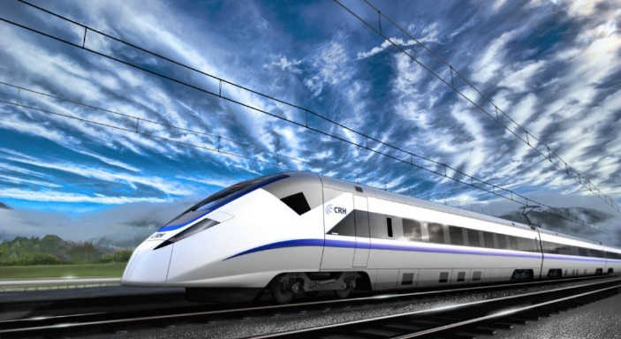
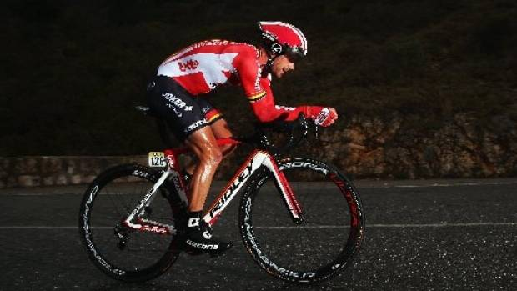

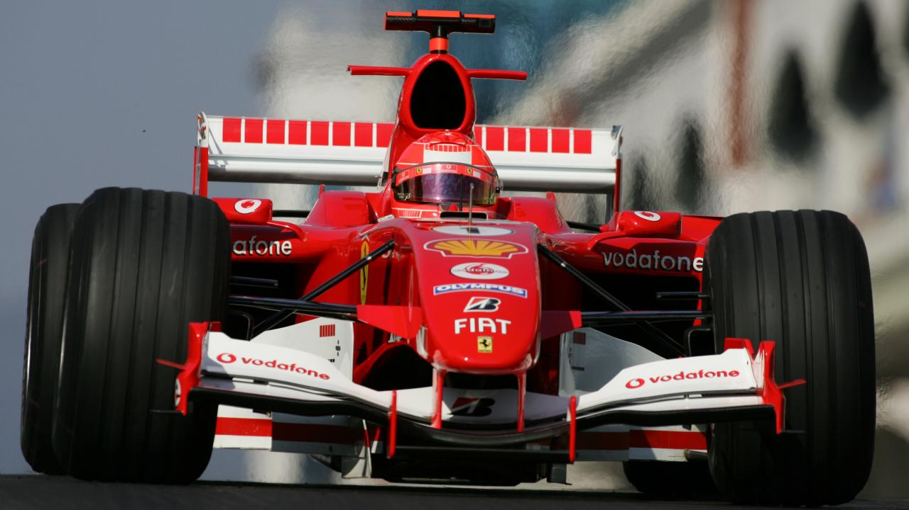

Drag
It is depends on
The relative speed of the object and the fluid
The density of the fluid
The area of the object facing the fluid
The shape of the object

Slide 4
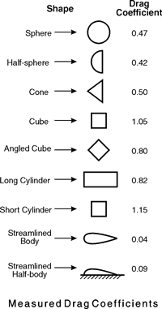
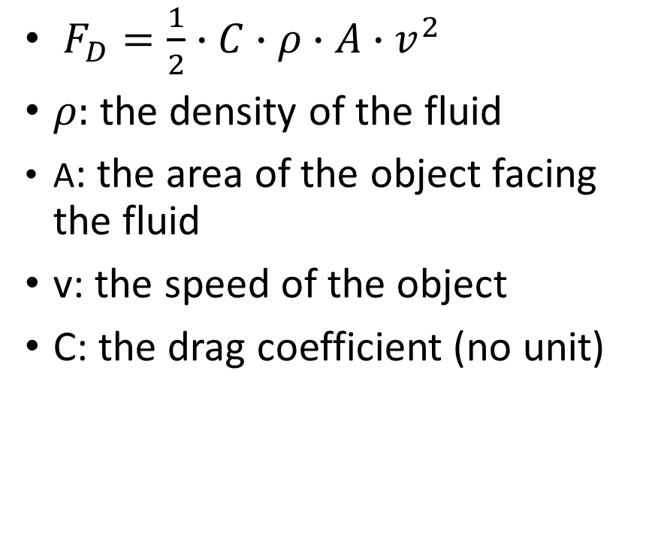
Drag-Formula
$F_{D}=\frac{1}{2}∙C∙ρ∙A∙v^{2}$
$ρ:$the density of the fluid
A: the area of the object facing the fluid
v: the speed of the object
C: the drag coefficient (no unit)

Slide 5
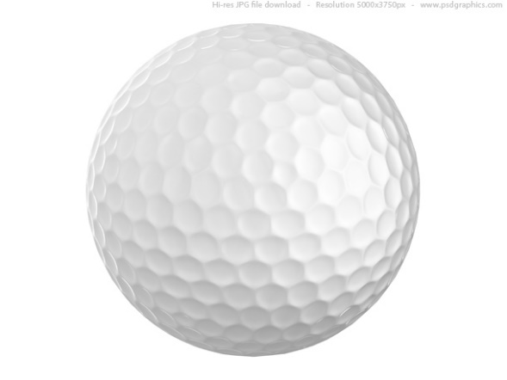
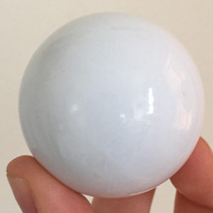
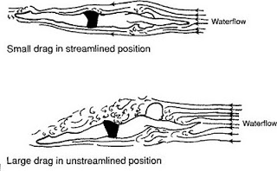
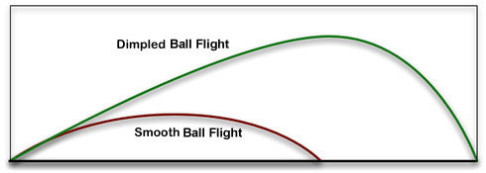

Reducing the drag

Slide 6
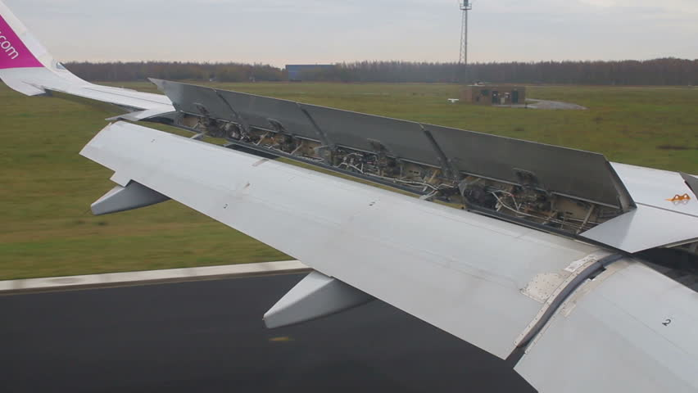
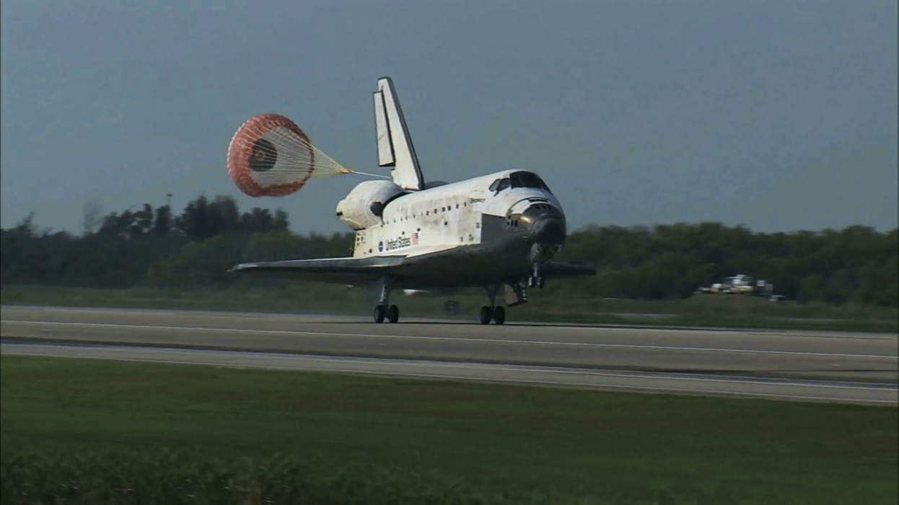
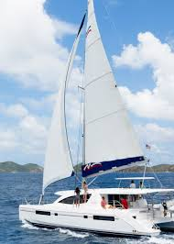
Increasing the drag

Slide 7
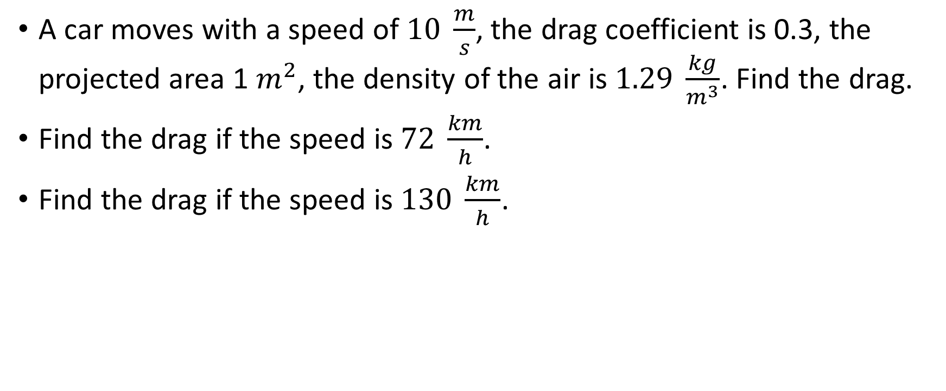
Problem 1.
A car moves with a speed of $10 \frac{m}{s}$, the drag coefficient is 0.3, the projected area 1 $m^{2}$, the density of the air is $1.29 \frac{kg}{m^{3}}$. Find the drag.
Find the drag if the speed is $72 \frac{km}{h}$.
Find the drag if the speed is $130 \frac{km}{h}$.

Slide 8

Problem 2.
A parachuter sinks with a constant speed. His mass is 80 kg (with the equipment). The drag coefficient is 1.2, the projected area is 25 $m^{2}$, the density of the air is $1.29 \frac{kg}{m^{3}}$. Find his speed.

Slide 9
https://www.youtube.com/watch?v=jFvB2SO2Rpw

